Slide 1
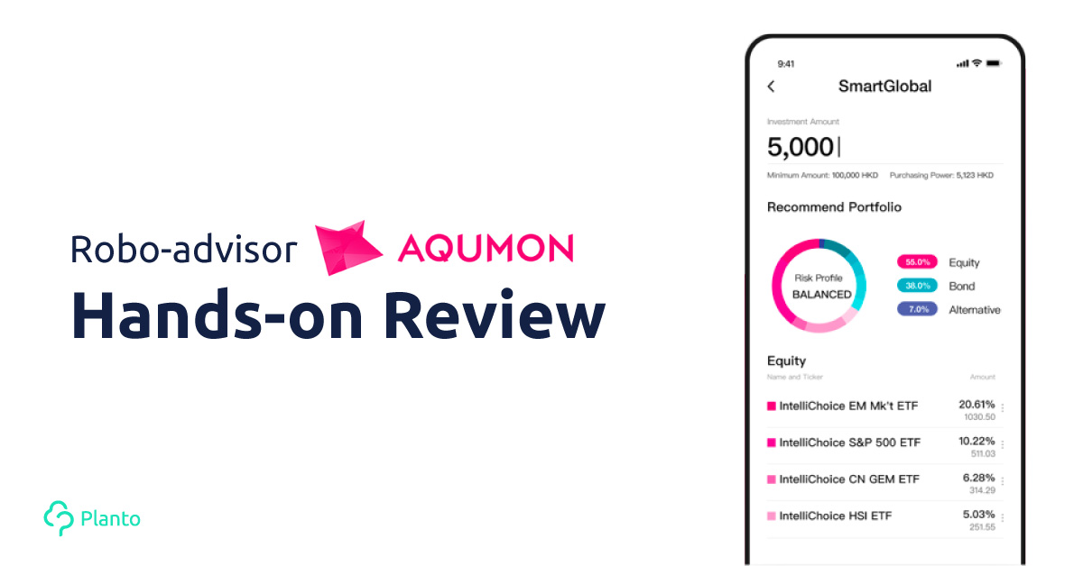
TEAM 9
Team member:
Dexin Mo Chenye Wang
Yihang Li Shuquan Yang
Yuan Liu Xiaojing Tang

Slide 2

AGENDA
Background & Funding history
Market Opportunity & Business Model
& Competitive Analysis
.
FinTech…
Strategy analysis: EF & BL
Replicate key component
Demo & future work
Q&A

Slide 3

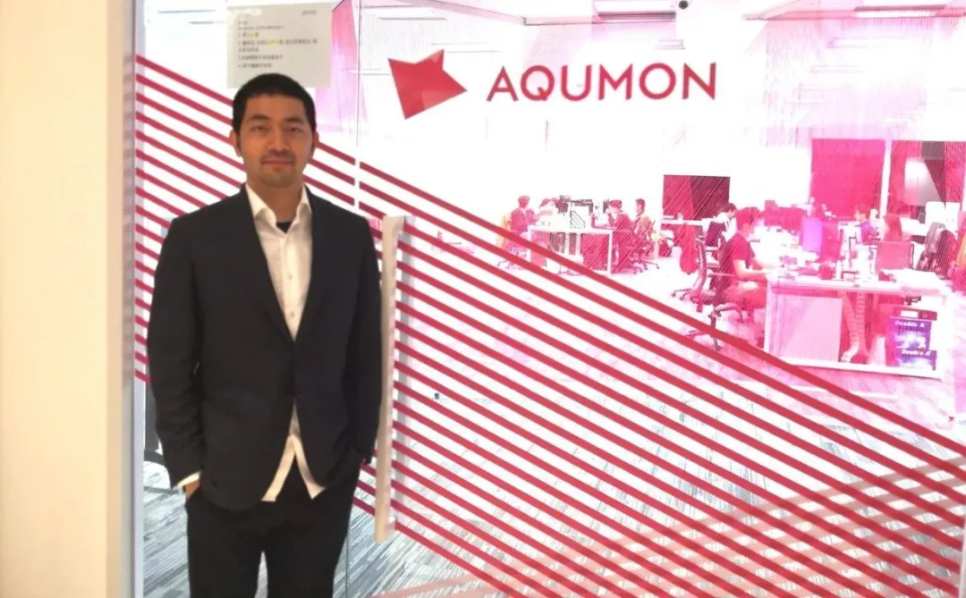

1. AQUMON Background
In 2016, AQUMON incubated from the Hong Kong University of Science and Technology, aim to become a leading startup company in the financial technology industry in Asia.
AQUMON is committed to providing transparent, stable, and low-cost financial services to more institutions and retail customers through the combination of finance, algorithms and technology.
AQUMON holds the Hong Kong Securities Regulatory Commission No. 1 (securities trading), No. 4 (advising on securities), No. 9 (asset management) licenses and the U.S. Securities Regulatory Commission Registered Investment Adviser (RIA) license.

Slide 4

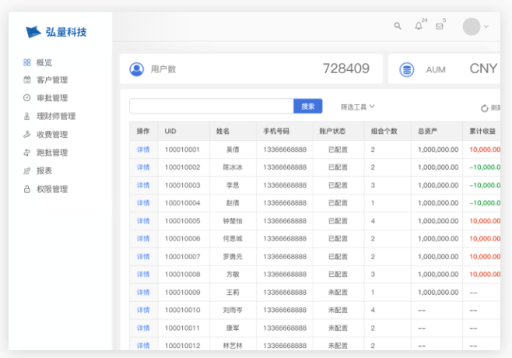
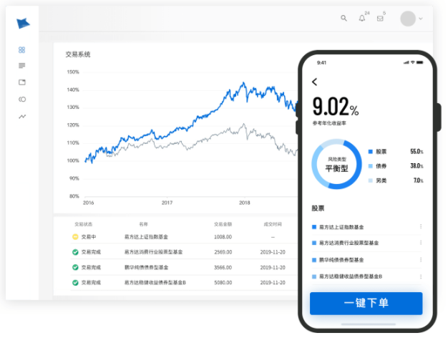


1. The founder's story
On May 1, 2008, in Hong Kong, Kelvin began his career in investment banking derivatives sales. But a month later there was a financial crisis.
When he first entered the industry, he experienced the highest peak of the industry, and then hit the top and fell, and his Season 2 began.
Start a business! In the robo-advisory field
Teammate, Huang Yaodong, PhD in financial engineering.
In 2015, Aqumon was born at the Hong Kong University of Science and Technology.
Original intention: bring the hedge fund-level investment opportunities that 5% of people could enjoy to 95% of ordinary people.

Slide 5








1. AQUMON’s funding history
2020-05-07
thirty million dollars
Pre B round
Zheng He Capital, Lenovo Ventures, Alibaba, Wing Lung Bank family,
Hong Kong government's Cyberport, etc.
2018-09-10
A++ round
2018-09-06
Alibaba
A+ round
L.P. Fund
2017-06-22
BOCI Investment
A round
Alibaba
Angel
round
Alibaba Hong Kong
Entrepreneurs Fund

Slide 6
2. Market Opportunity – Democratize Hedge Funds
Aqumon’s goal is to bring the hedge-fund-level investment opportunities that are available to 5% of the population to 95 per cent of the population
Pain Points
Hedge funds are only open to "accredited" or qualified investors.
Qualified investors of a hedge fund refer to the entities and individuals with corresponding risk identification ability and risk bearing ability.
In mainland China:
Invest not less than 1 million yuan in a single hedge fund.
Enterprises with net assets not less than 10 million yuan;
Individuals whose financial assets are no less than 3 million yuan or whose average annual personal income is no less than 500,000 yuan in the recent three years.
Retail Investors do not have the access to many financial instruments that are only available for big institutions.
Financial Derivatives for hedging, such as options and futures
Global Asset Allocation

Slide 7
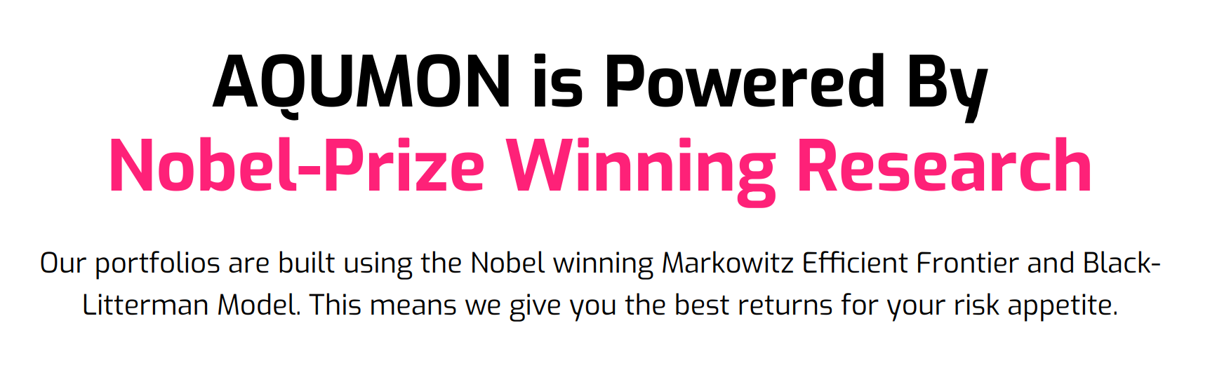
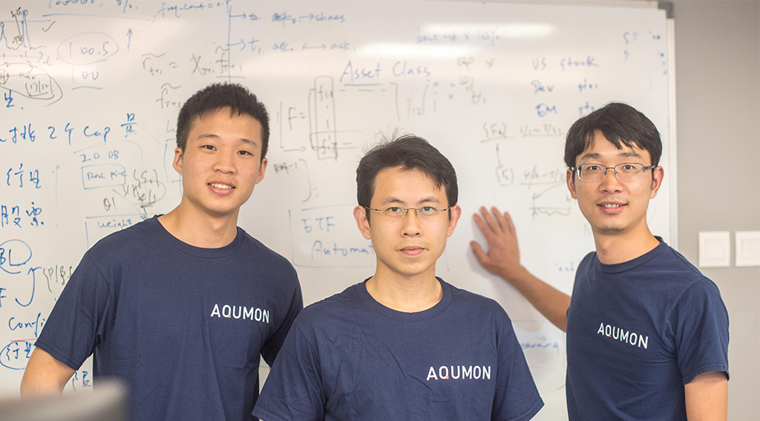

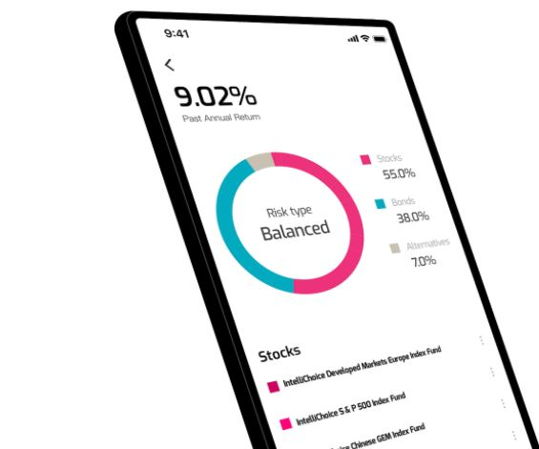
2. Business Model
Quantitative technical support for professional investment institutions
Sales Revenue from sale of algorithms and strategies to financial institutions

Slide 8

2. Competitive Analysis
Comparison : Traditional Human Advisor
Historically, there’s been a couple of major ways you could invest your money:
Do it yourself. Which means you would need to do tons of research into stocks, ETFs, bonds etc.
Turn to the investment managers for help. Buy mutual funds or an investment insurance where you would essentially pay an investment manager to do the same with fees that are often 2% or more!
Robo-advisors are computer programs that will collect some information about you .Once you put your money in, they will automatically invest it on your behalf and since there’s no human intervention, they can cut costs and make management fees much lower for the consumers!

Slide 9
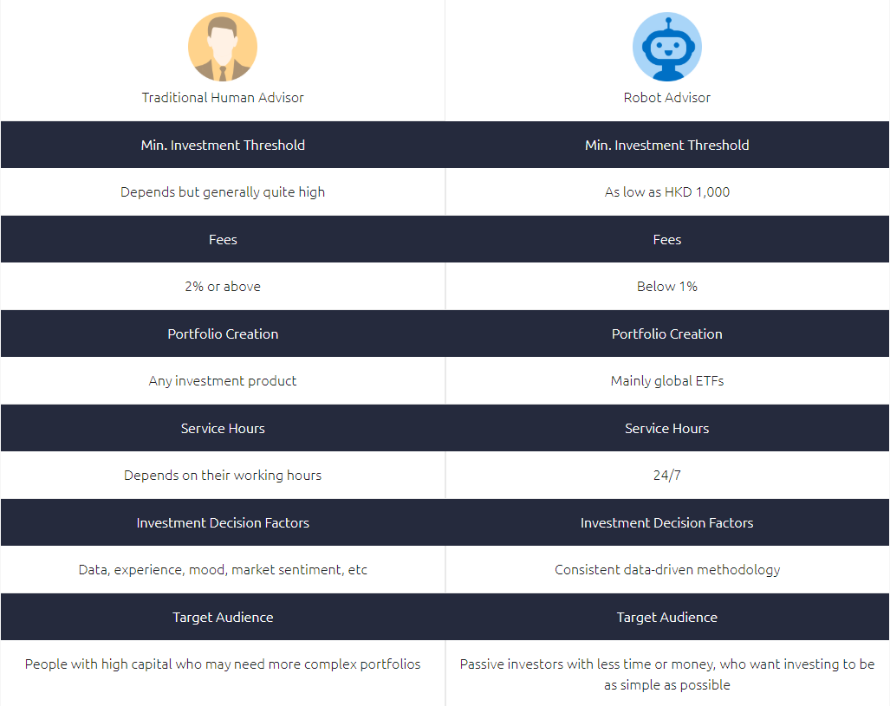

Slide 10



Comparison : Robo-Advisors in HK
Category | AQUMON | Kristal.ai | SoFi Hong Kong (Chloe)
Fees(annual) | 0.4% | 0% | 0%
Min Investment Amount | HK$7,800 | HK$1,000 | HK$1,000
Target Market | HK & US | HK & US | HK
Investment Asset | ETF (stocks, bond, oil/gold) | ETF (stocks, bond),REITs | ETF (stocks, bonds)
Rebalance Frequency | Quarterly/Monthly | Every six months | Irregular adjustment
Employees number | 40 (3% up) | 1634 (1% up) | 85 (5% up)
Employee rating | 4.2 | 3.3 | 4.6

Slide 11
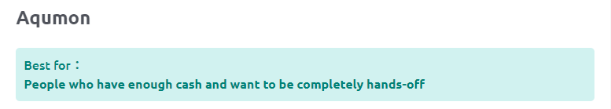


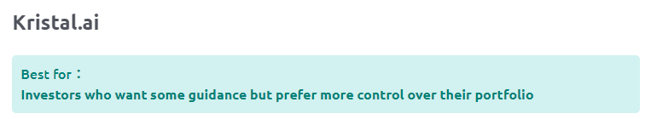
Strong past performance (> 20% in 2019) and high transparency
All ETFs in the portfolio are carefully analyzed and selected
Easy to use app. Even if you have no accounts, the app has useful information on how to start investing
Uses US ETFs which charge lower fees
PROS
CONS
Minimum investment amount is slightly higher than other robo-advisors

Slide 12
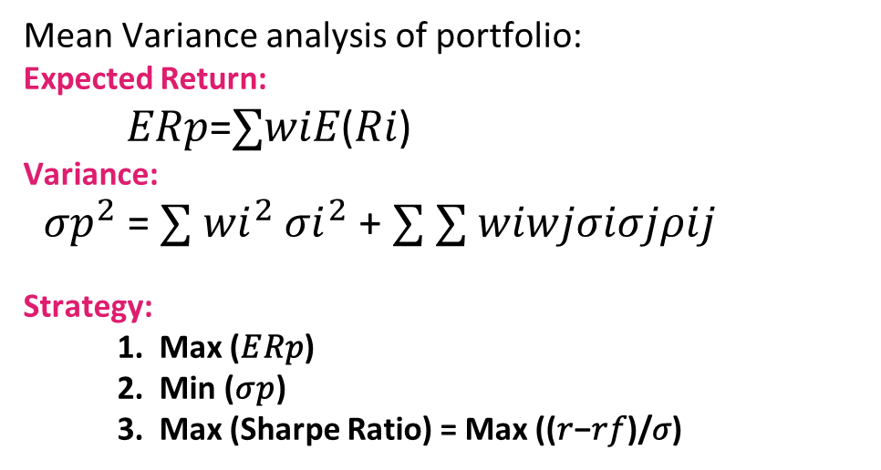
3. Strategy analysis: Markowitz efficient frontier
Mean Variance analysis of portfolio:
Expected Return:
𝐸𝑅𝑝=$∑$𝑤𝑖𝐸(𝑅𝑖)
Variance:
${σp}^{2}$= $∑ {wi}^{2}$ ${σi}^{2}$+ $∑ ∑$𝑤𝑖𝑤𝑗𝜎𝑖𝜎𝑗𝜌𝑖𝑗
Strategy:
1. Max (𝐸𝑅𝑝)
2. Min (𝜎𝑝)
3. Max (Sharpe Ratio) = Max ((𝑟−𝑟𝑓)/𝜎)

Slide 13
3. Strategy analysis: Black Litterman
Why improve?
Resulting portfolios of MVO tend to perform shockingly badly in practice, worse than if you were to just equally-weight the assets.
As it happens, the major cause of problems is the use of mean historical returns to estimate future returns.
The Black-Litterman model attempts to improve on this by using a clever Bayesian scheme to construct the expected returns vector.

Slide 14
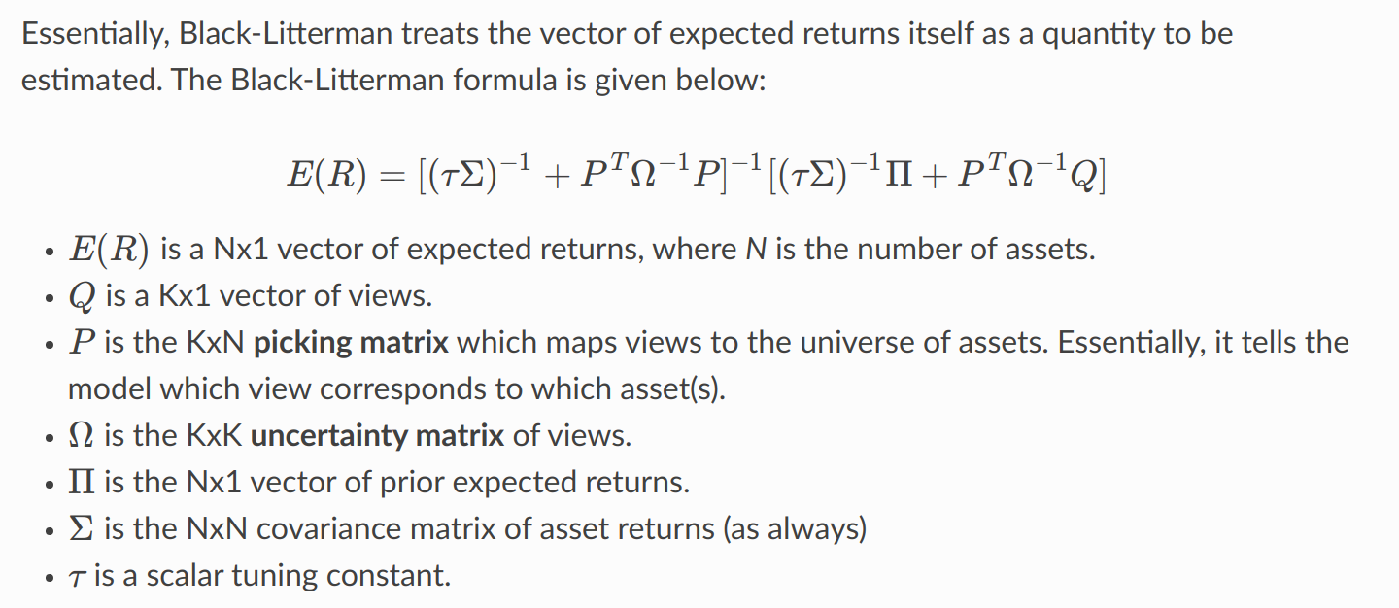
3. Strategy analysis: Black Litterman
Basic idea

Slide 15
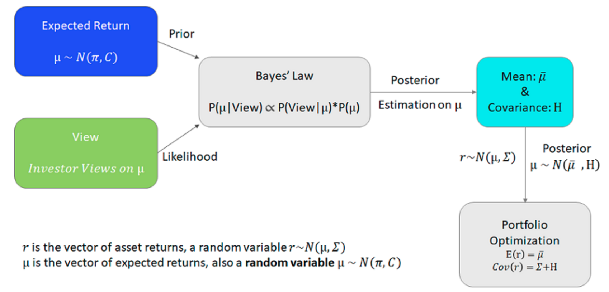
3. Black Litterman:
Essentially Beysian Method

Slide 16
4. Replicate key component: Basic Assumptions
In our toy example, our universe has only Top20 (by Market Cap) S&P500 symbols. Though in real case, our base assets can be any global asset such as stocks, bonds, ETF and so on. We can do that for real case.
We use 10-Year Treasure Rate of the day 09/30/2020, which is 1.01% as our risk-free-rate. Data range to 09/30/2020.
Views: Use the annualized mean return of next two month’s return as our views. In real case, we can combine with some machine learning tectonics such as LSTM or some Time Series Prediction methods to generate our views. (absolute views)
For Back-testing, We choose the month 1, 3, 6, 9 as our rebalance months. Set start cash as 10,000, and commission rate as 0.003.

Slide 17
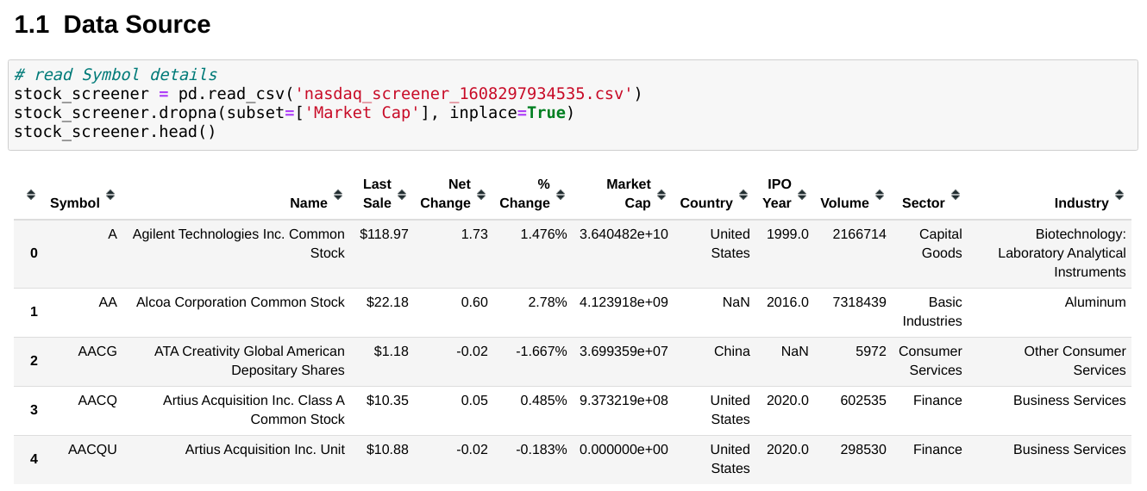
4. Replicate key component: Data info

Slide 18
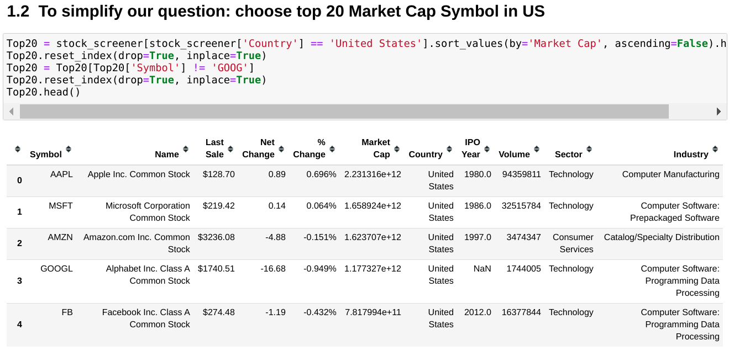
4. Replicate key component: Data info

Slide 19
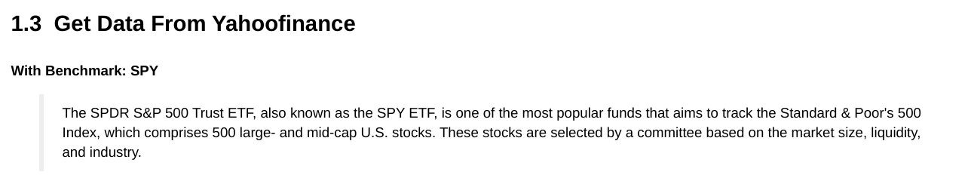
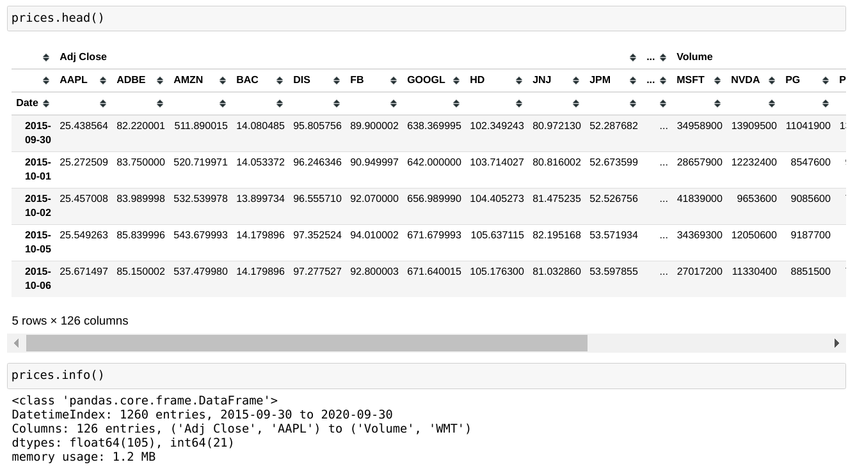
4. Replicate key component: Data info

Slide 20
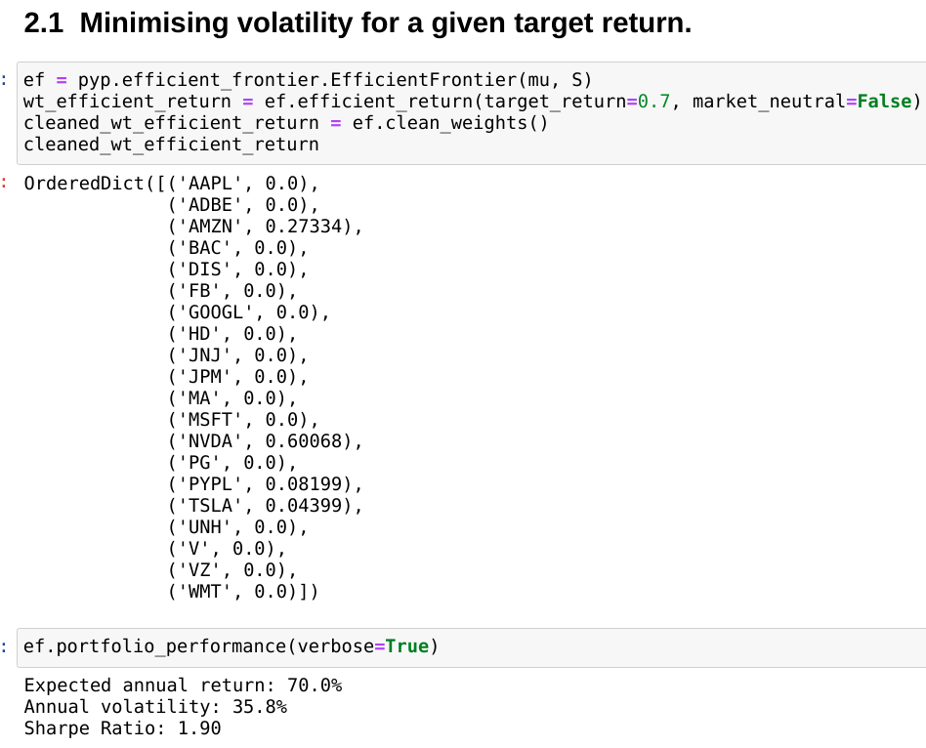
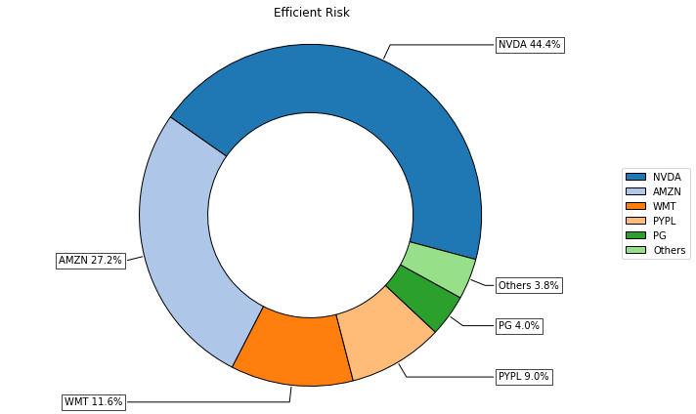
4. Efficient Frontier —— Minimize Risk

Slide 21
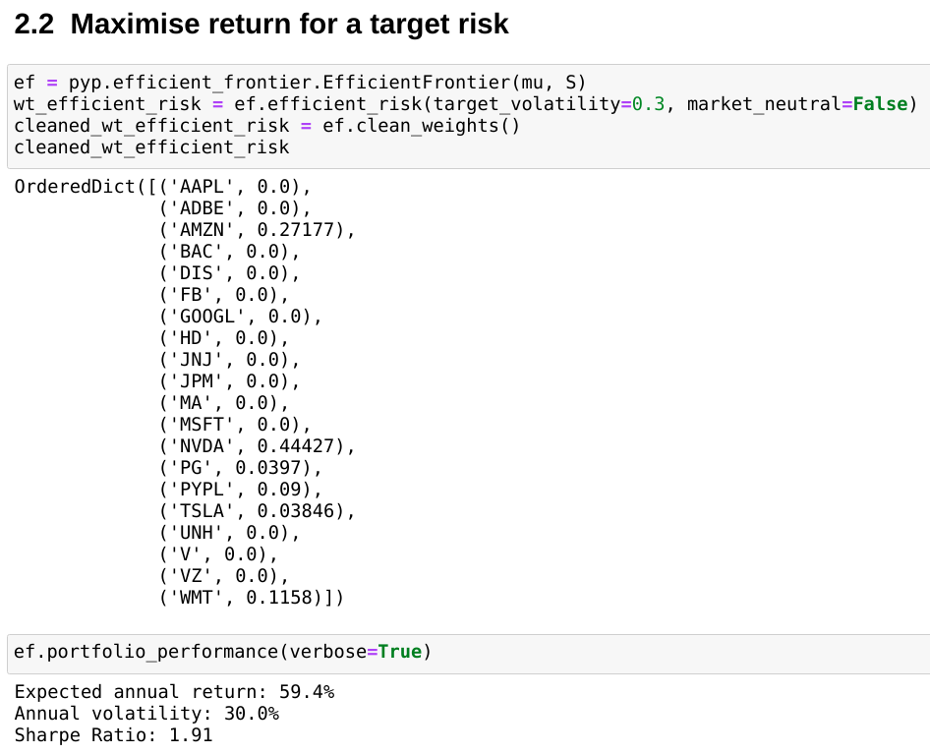
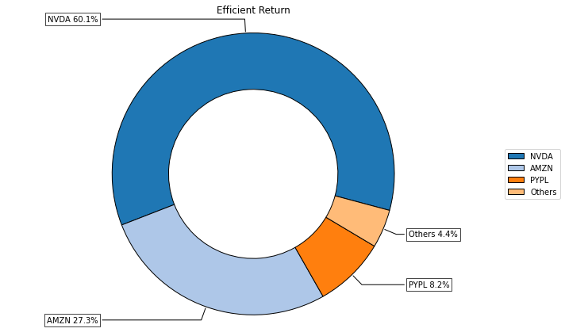
4. Efficient Frontier —— Maximize Return

Slide 22
4. Black Litterman: Create Views
A view is just a forecast you have of the future returns of an asset. It is different to the expected returns vector required by Efficient frontier optimisation
Use the annualized mean return of next two month’s return as our views.
In real case, we can combine with some machine learning technichs such as LSTM or some Time Series Prediction methods to generate our views. (absolute views)
需要调整

Slide 23
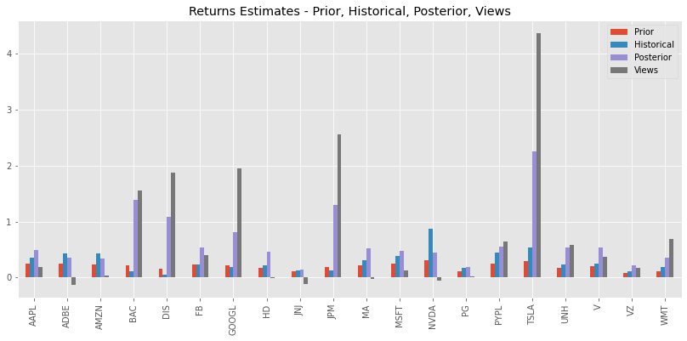
4. Black Litterman: Estimated Returns for Prior, Hist, Posterior, Views

Slide 24
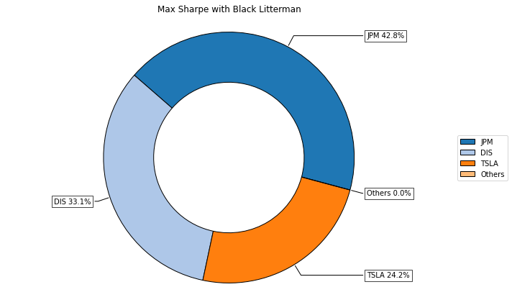
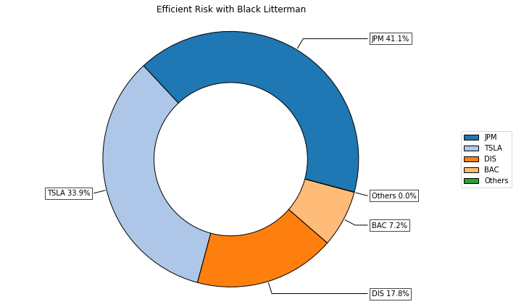
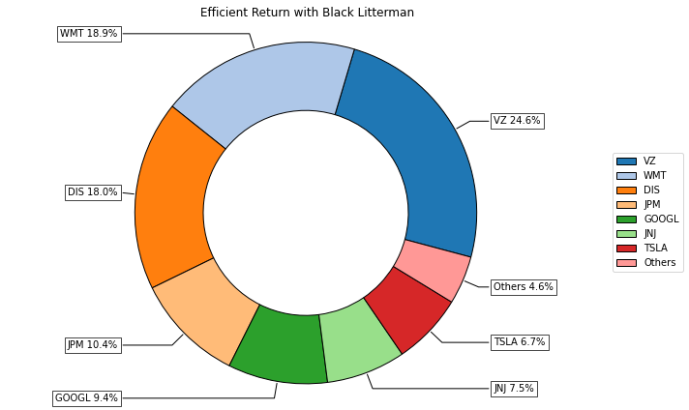
4. Black Litterman Results: combine with above 3

Slide 25
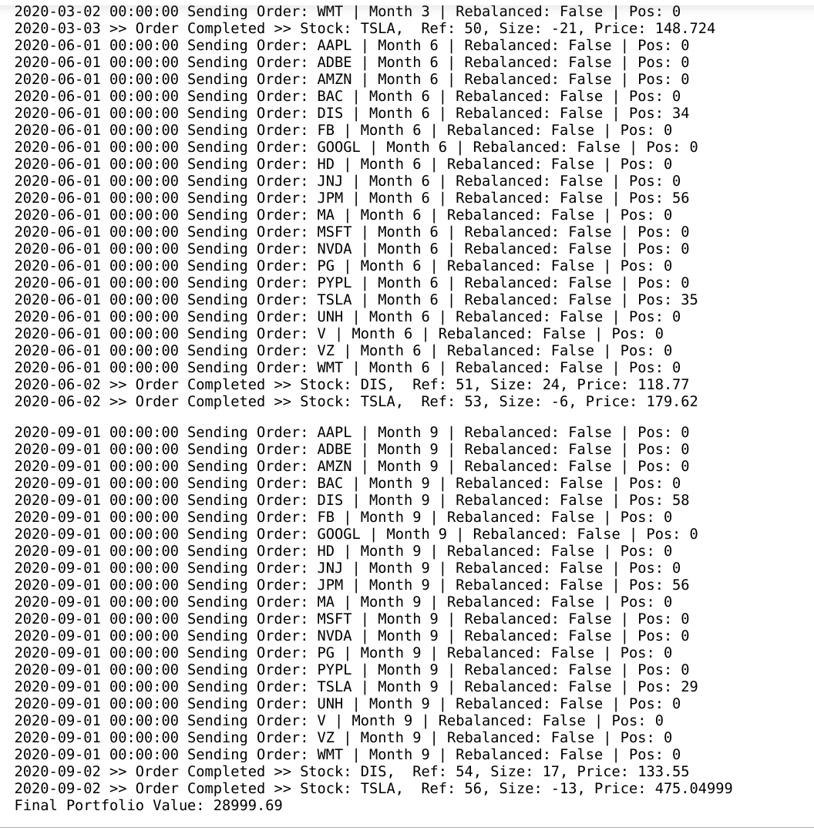
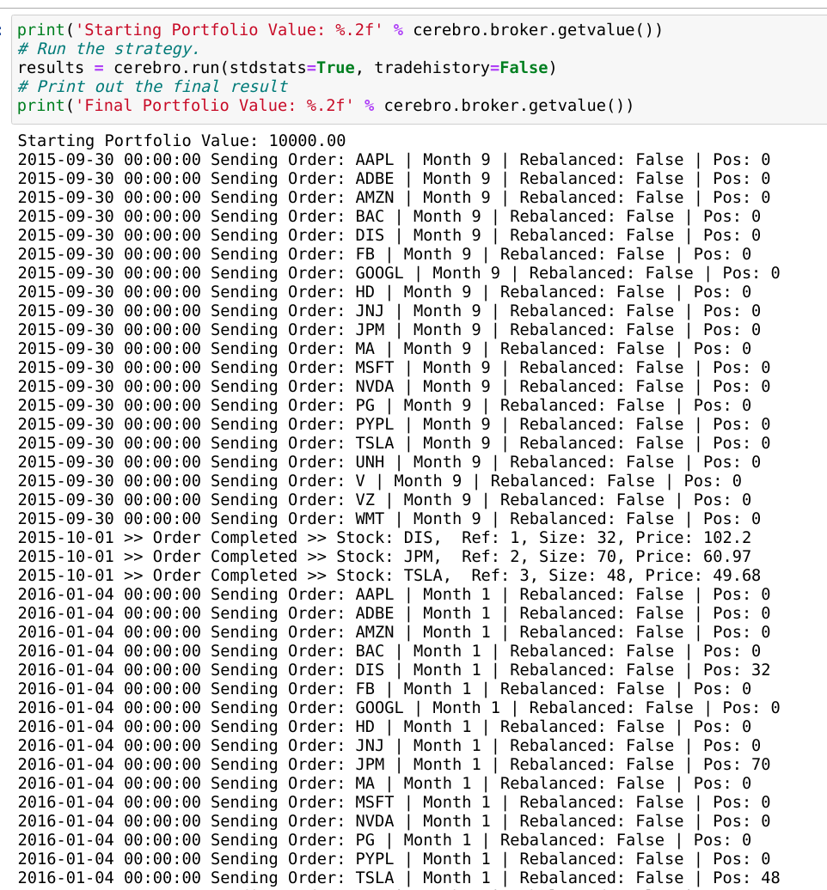
4. BackTest: Take BL+Max Sharpe ratio as example
For Back Testing, We choose the month 1, 3, 6, 9 as our rebalance months. Set start cash as 10,000, and commission rate as 0.003

Slide 26
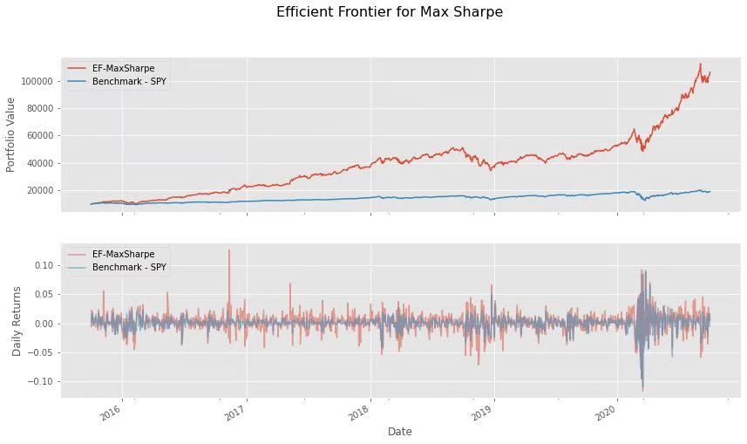
4. BackTest: Result

Slide 27
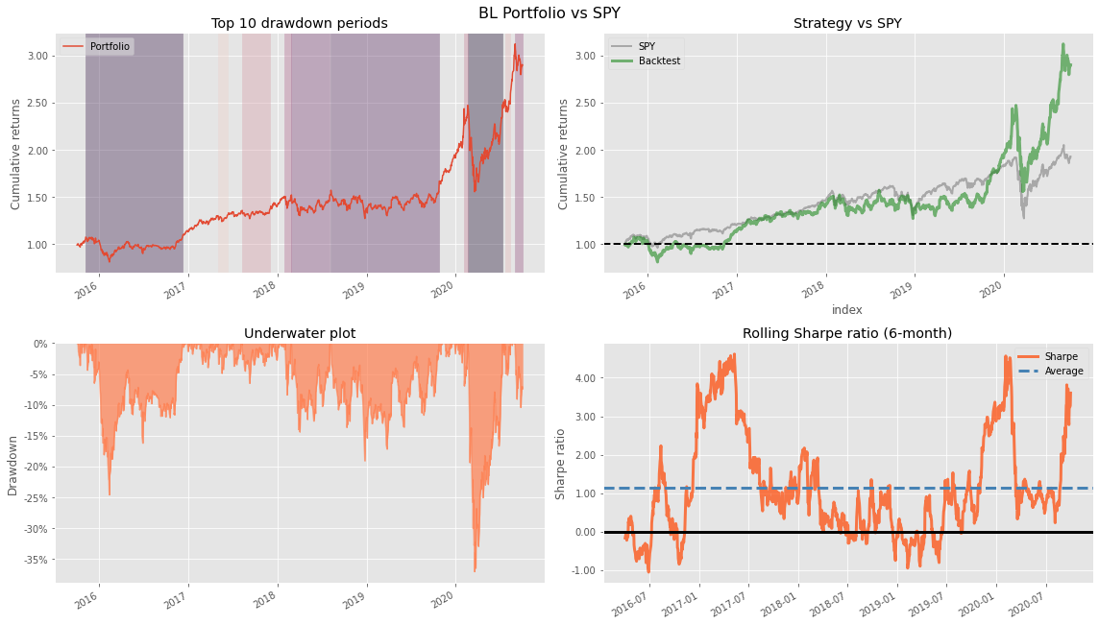
4. BackTest: Performance

Slide 28
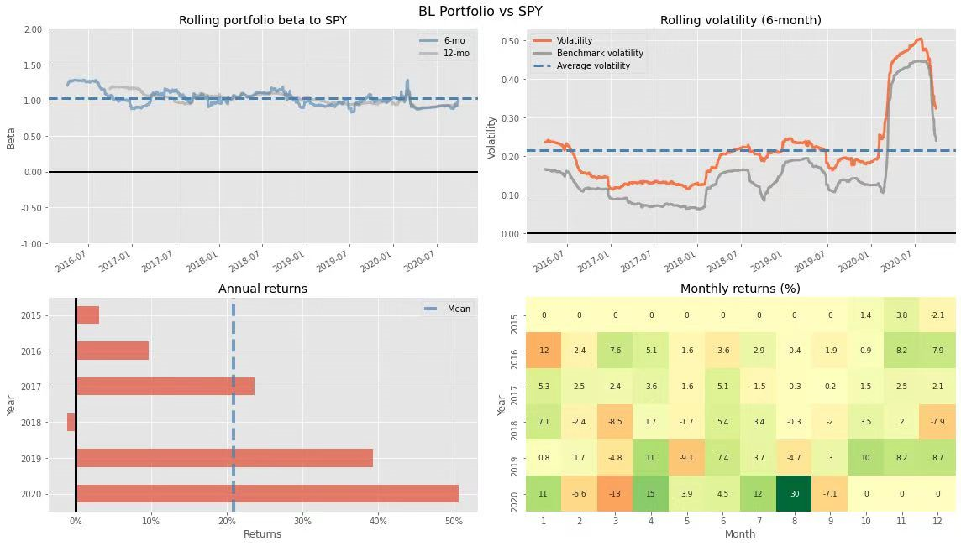
4. BackTest: Performance

Slide 29
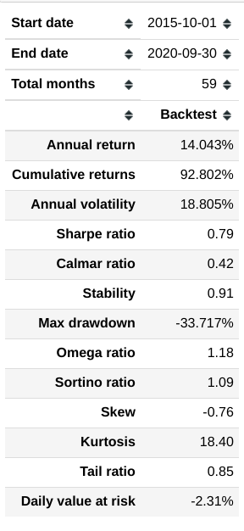
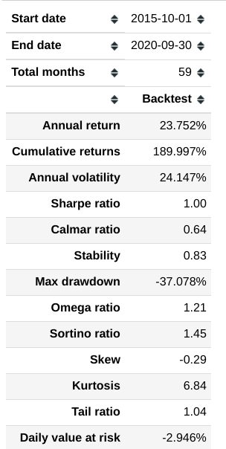
4. BackTest: Performance
SPY
Black
litterman

Slide 30
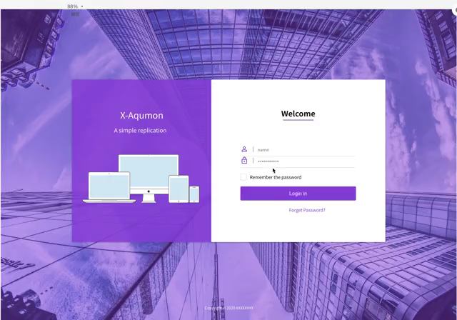
4. Webpage display

Slide 31
4. Our future work

Slide 32
AQUMON Robo-Advisors
Thank you for your attention.
MDS 6212: Team 9

Slide 33
AQUMON Robo-Advisors
Q & A

